Slide 1

IMDB Movie Analysis
Final Project-1

Slide 2




INTRODUCTION
IMDB is well known movie and series rating site for users and critics worldwide;
In IMDB we can find movies or series' rating as well as its directors and actors compiled profile as well as financials of it
We were given the dataset for movies from 1920 to 2010 and were expected to answer certain questions by using the data given in the dataset
The method called “Five Whys” of analytics was asked to be used for the completion of this project and at the conclusion we’ll get to know how this method helped in achieving the required answers.

Slide 3


APPROACH AND TECH-STACK USED
This project’s work started with understanding and cleaning of the data(by removing null values, unimportant rows, etc.).
After the cleaning pivot table, various functions, and charts were used for desired answers of the questions
The insights then succeeded with proper formatting in table and graphs.
For this IMDB Movie Analytics Project, I used the MS Excel, reason being – this software is excellent at Data Handling and at performing daily tasks and also at managing big businesses.

Slide 4
INSIGHTS
Director | Actor | Title | Year | Score | Profit
James Cameron | CCH Pounder | Avatar | 2009 | 7.9 | 523505847
Colin Trevorrow | Bryce Dallas Howard | Jurassic World | 2015 | 7 | 502177271
James Cameron | Leonardo DiCaprio | Titanic | 1997 | 7.7 | 458672302
George Lucas | Harrison Ford | Star Wars: Episode IV - A New Hope | 1977 | 8.7 | 449935665
Steven Spielberg | Henry Thomas | E.T. the Extra-Terrestrial | 1982 | 7.9 | 424449459
The question here that was put up was to find the most profitable movies as per the dataset.
This table here represents the top 5 most profitable movies(acc. To the given data).
The chart shows how the profit and budget configurations look like for the movies given in the dataset.
Here the outliers are the separated dots which disturb the whole configuration and are listed in the box next to the chart.
This data tells us that Avatar is the most profitable movie in between 1920 to 2010 with 523 million in profit and the score it has is 7.9.
OUTLIERS
-12213298588
-4199788333
-2499804112
-2397701809
-2127109510

Slide 5

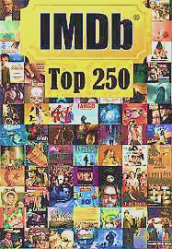
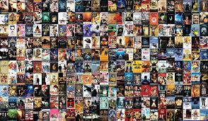
INSIGHTS
Next question was to find out and put up the Top 250 IMDB movies as per their respective IMDB score.
To put up a table of 250 rows in a slide was a hectic task so the link of the sheet with all the data with answers is given below.
The table of IMDB_Top_250 shows that Frank Darabont’s “The Shawshank Redemption” has the highest IMDB score of 9.3 followed by “The Godfather” and “The Dark Knight”.
Foreign Language movie with highest IMDB score of 8.9 is Sergio Leone’s “The Good, the Bad and The Ugly”.
LINK:- https://docs.google.com/spreadsheets/d/1z2PMJYB4ahTSf0A7GY3tBCmKZgGK97wD5na2URKEvLs/edit?usp=sharing

Slide 6
Top 10 Directors | Average IMDB score
Charles Chaplin | 8.60
Tony Kaye | 8.60
Alfred Hitchcock | 8.50
Damien Chazelle | 8.50
Majid Majidi | 8.50
Ron Fricke | 8.50
Sergio Leone | 8.43
Christopher Nolan | 8.43
Asghar Farhadi | 8.40
Marius A. Markevicius | 8.40
INSIGHTS
Next question was to find out the top 10 directors as per their respective average IMDB scores.
For this , pivot tables, filtering and sorting was used and the resultant table is the one displayed beside.
The graph is the visualization of the above table which shows that Charles Chaplin and Tony Kaye share same top average score of 8.60 followed by Alfred Hitchcock, Damien Chazelle, Majid Majidi and Ron Fricke sharing average score of 8.50

Slide 7
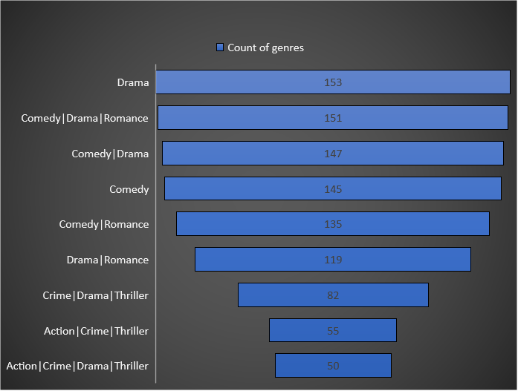
INSIGHTS
Next question was to find out the most popular genres of movies among the data given between the years 1920-2010.
The chart shows the most repeated genres in the column of genres .
The Drama genre has most repetitions(153) being the most popular among genres followed by Comedy|Drama|Romance with 151 repetitions.
People liking Drama and Comedy the most is the main reason of the most repetitions of these two aspects in popular genres.

Slide 8
INSIGHTS
Next task was to find the audience-favorite and critic-favorite actors.
For this, three actors ; Brad Pitt, Leonardo DiCaprio and Meryl Streep, are considered with rows of their movies with number of users for reviews and number of critics for reviews are lined up.
For the respective actors, the movies with no. of users and critics are added up and the mean for a specific movie is taken out of the numbers and put up in a table(table is given in the spreadsheet).
The visualization of the above table is the 1st Graph showing that Leonardo DiCaprio is audience favorite and Critics favorite among the top actors.
The second Graph shows the change in number of voted users over decades.

Slide 9




CONCLUSION
In this project of IMBD Movie Analysis, I have gained various Logical, Statistics and Technical Skill by searching for desired answers from the dataset.
Some statistical concepts like Average, Frequency Table, and Discovering Outliers that helped me better connect with data, offered me a thorough understanding of it, and aided in the analytics of supplied data.
I also get a sense of how visual representation of data makes it very simple to understand
I got to learn about the Five Whys Method and how and when to ask certain questions in analytics to get the right answers.

